Slide 1
Developing Integration Solutions using Microsoft BizTalk Server 2016
Introduction to BizTalk Server 2016

Slide 2
Course Outline
Module 1: Introduction to BizTalk Server
Lesson 1: Core Architecture and Infrastructure
Lesson 2: BizTalk Server Development
Lesson 3: BizTalk Server Administration
Module 2: Schemas
Module 3: Maps
Module 4: Testing and Deploying Projects
Module 5: Pipelines
Module 6: Routing
Module 7: Adapters
Module 8: Web Services and WCF
Module 9: Introduction to Orchestrations
Module 10: Applied Orchestration Techniques
Module 11: Business Activity Monitoring
Module 12: Integrating Business Rules
Module 13: Deploying and Managing Applications
Extra modules

Slide 3
Lesson 1: core architecture and infrastructure
Introduction
Evolution
Editions
Infrastructure Architecture
Artifacts and Components

Slide 4

What is BizTalk?
“Microsoft BizTalk Server is used to simplify and automate the exchange of information between publishers and subscribers, to orchestrate and supply insight into business processes”

Slide 5











What major pain points does BizTalk solve?
Need to Integrate systems
Inconsistent information from disparate sources
Lack of competency and standards
Want to Automate processes
Inefficient manual processes
Time consuming and focus disturbing
Want insight in information flow
Lack of asset and process visibility
Missing control and re-usability
ERP
HR
E-Commerce
CRM

Slide 6

What major pain points does BizTalk solve?
Must Simplify change
Overwhelmed by frequent business changes
Find it hard to manage business rules and processes
Time consuming development, deployment and management
Need to empower developers to be productive
Many hours spent on building effective plumbing
Even if using plumbing enhanced frameworks like WCF

Slide 7
Why use BizTalk for integration?
“We use .NET, WCF, Web Services, REST, JSON, we have FTP servers, File servers and other integration products and technologies from Microsoft, can’t we solve this without BizTalk?”
“Yes, but…”
Notes:
Utbyte av information mellan system

Slide 8
For on-premise integration, BizTalk has all this, and more, out of the box
Load Balancing
Availability Monitoring
Identity & Impersonation
Thread Management
Multi-environment Deployment Model
Message Tracking
Failed Message Management
Configuration Management
Scale-out Configuration
Disaster Recovery
Regulatory Compliance
Composite State Management
Fail-over
Health Monitoring
Scripting & Programmability APIs
Memory Management
Service Isolation
Utilization/Performance Tracking
Archiving & Purging
Exception Configuration
Throttling

Slide 9
What about Azure? – Hybrid based on BizTalk

Slide 10




What about Azure? – Cloud only
Azure Integration Services
https://aka.ms/integrationpaper
Logic Apps
API Management
Service Bus
Event Grid

Slide 11

What about Azure? – Hybrid based on Azure
Integration Service Environments In private preview, public preview coming next year
VNET connectivity
Private static outbound IPs
Custom inbound domain names
Dedicated compute
Isolated storage
Flat cost

Slide 12















Hybrid based on Azure
Machine Learning
Connect on-premises, hybrid and cloud applications
Run mission-critical, complex integration scenarios with ease
Service Bus
Logic Apps
Cognitive Services
Integration
Service
Environment
B2B & EDI
API Management
On-premises data gateway
BizTalk Server

Slide 13
BACK TO BIZTALK…

Slide 14

Evolution
2000
2002
2004
2006
2006 R2
2009
2010
2013
2013 R2
2016
2004, core engine
2006, 2005, Applications, perf.
2006 R2, EDI, RFID, WCF, Adapters
2009, 2008, ESB, EDI, Adapters, ALM
2010, 2010, Mgmt, ESB, Adapters, productivity, B2B,
AppFabric & WF
2000 – First version
2004 – Core engine
2006 – Applications
2006 R2 – EDI, RFID, ECF, Adapters
2009 – ESB, EDI. Adapters, ALM
2010 – Mgmt, ESB, Adapters, Productivity
2013 – JSON, Azure, Adapters, HL7, Health monitoring
2016 – AlwaysOn, Azure, SHA2, Productivity, Security, Adapters

Slide 15
BizTalk Server 2016 New or updated features
Feature | Description
Support for newer platforms | BizTalk Server 2016 adds support for the following Microsoft platforms:
 | - Visual Studio 2015
 | - Windows Server 2016
 | - SQL Server 2016
 | - Office 2016
SQL Server 2016 AlwaysOn Availability Groups | Support includes:
 | - Using on-premises and in Microsoft Azure IaaS virtual machines
 | - Using for production workloads
 | - Provides a high available (HA) solution in Microsoft Azure
BizTalk Server Azure VMs in production | BizTalk Server Azure virtual machines are now fully supported for production environments. Using SQL Server 2016 AlwaysOn, a highly available solution is now possible.
Logic App adapter | Connect to your Logic Apps hosted in Azure, and get access to all the connectors including Salesforce, SharePoint, CRM Online, and more. For example, you can receive an order in BizTalk Server, connect to your Logic App, and update Salesforce.
File adapter | Connect to an Azure storage file share. You can receive files from the Azure file share, and send messages to an Azure file share.
FTP adapter | SYST command is no longer required. When you configure the FTP adapter on a receive location or send port, there is a property called FTP Server Type. Using this property, you choose the FTP server you want; which determines if SYST is required.
 | As a result of this change, there are more "supported" FTP servers.
SFTP adapter | SFTP adapter is re-engineered to use WinSCP to connect to SFTP; which allows support for more SFTP servers. Client-side logging and additional encryption ciphers are also new.

Slide 16
BizTalk Server 2016 New or updated features
Feature | Description
Allow import of tracking settings | When importing a binding a file, you can choose to import (or not import) the tracking properties enabled on your orchestrations, send ports, and so on. This is a global setting (set at the Group level) so you can set this feature in your different environments. For example, you can import the existing tracking properties for your Development environments, and don't import the tracking properties for your Production environments.
Shared Access Signature (SAS) | You can use SAS authentication for the Service Bus connection with the BasicHttpRelay, NetTcpRelay, BasicHttp, and WebHttp adapters.
 | WCF-BasicHttpRelay adapter
 | WCF-NetTcpRelay adapter
 | WCF-BasicHttp adapter
 | WCF-WebHTTP adapter
Ordered delivery on dynamic ports | Applies to the adapters that support ordered delivery on static send ports. You can enable the ordered delivery option in the BizTalk Administration console.
SHA-2 hash functions | SHA-2 is fully supported, including:
 | BizTalk can consume SHA2-signed certificates across all of its components
 | Supports the following Advanced Encryption Standard (AES) exchange system for signature keys in AS2, RosettaNet, and the MIME/SMIME encoder: AES128, AES192, AES256
 | Supports the following SHA2-based MIC calculations for AS2: SHA256, SHA384, SHA512
 | Supports the following SHA2-based digest methods in RosettaNet: SHA256, SHA384, SHA512
 | SHA1 certificates will continue to work

Slide 17
BizTalk Server 2016 New or updated features
Feature | Description
Compile your maps | Choose to compile your maps using XslTransform or XslCompiledTransform
Schema window | In the BizTalk mapper, you add/replace a source schema and a destination schema. When you do this, the Type Picker window is now resizable. This changes allows you expand the window, and see the full name of your schema.
Office web components (OWC) | Office web components (OWC) is now an optional installation component.
Adapters and Accelerators | Improvements and changes include:
 | - SAP adapter now uses SAP Connector for .NET (NCo), while still supporting the classic RFC SDK. WCF-SAP adapter support for the SAP .NET Connector provides more details.
 | - BizTalk Accelerator for HL7: The MLLP adapter on a receive location now supports the option to initiate an outbound connection to a remote LOB listener.
Import/export parties | Changes include:
 | - The import and export option is separated from the Application. For example, you can export a party without exporting the application. You can import a party without importing the application.
 | - Can choose which parties, business profiles, and agreements you want to import or export
 | - Can continue to import/export the business-to-business artifacts as you do in BizTalk Server 2013 R2, BizTalk Server 2013, and BizTalk Server 2010.
BizTalk Administration | In addition to a more modern look and feel, some additional changes include:
 | - Configure the settings for multiple hosts/host instances simultaneously. For example, you can set the .NET CLR settings for multiple host instances simultaneously.
 | - Use the new Search feature to filter and find artifacts in your application, such as schemas, resources, and more.
 | - When troubleshooting suspended messages, you can save multiple suspended messages simultaneously to a file.

Slide 18
BizTalk Server 2016 Deprecated & Removed
Program | Status | Replacement
RFID Mobile | Removed | None
RFID Server | Removed | None
SharePoint SSOM/Web Service adapter | Removed | Use the CSOM (Client Side Object Model) option.
SOAP adapter | Deprecated | WCF-BasicHttp Adapter
Old SQL adapter | Deprecated | WCF-based SQL adapter in the BizTalk Adapter Pack
UDDI | Removed | None

Slide 19
FEATURE PACKS
Feature Pack 1
Released April 2017
Feature Pack 2
Released November 2017
Feature Pack 3
Released June 2018

Slide 20
Feature packs
Installs
BizTalk Server 2016 Feature Pack 1 contains Cumulative Update 3
BizTalk Server 2016 Feature Pack 2 contains Feature Pack 1 (and CU3)
BizTalk Server 2016 Feature Pack 3 contains Feature Pack 1&2 (and CU5)
You need
BizTalk Server 2016 Enterprise (or Developer)
Licensing for production use
Software Assurance ; or
Running BizTalk Server in Azure VMs using an Azure Enterprise Agreement

Slide 21
BTS 2016 Feature Pack 1
Deployment
Runtime
Analytics
Application Lifecycle Management
Application Lifecycle Management to deploy and update BizTalk Server instances using Visual Studio Team System (VSTS)
Advanced Scheduling Set up recurrence on BizTalk Server receive locations with greater precision using time zones, months, weeks, and days
SQL Server Encrypted Data Read and write to SQL Server always encrypted columns using BizTalk Adapter for SQL Server
Web Administration
Manage BizTalk Server environments using standard RESTful Web services APIs
Application Insights
Send BizTalk Server tracking data to Application Insights for extensible analytics, to understand performance and usage of BizTalk Server
Power BI Analyze and report BizTalk Server tracking data using Power BI BizTalk operational data template, for use with Power BI visualizations and dashboards

Slide 22
BTS 2016 Feature Pack 2
Deployment
Runtime
Analytics
Application Lifecycle Management v2
Application Lifecycle Management to deploy and update multiple BizTalk Server instances using Visual Studio Team System (VSTS)
Backup to Blob Storage
Backup BizTalk Server database job to Azure Blog Storage
Adapter for Service Bus v2 Send and receive messages with Azure Service Bus (partitions)
Transport Layer Security 1.2 Securely deploy BizTalk Server using TLS 1.2 authentication and encryption
API Management Publish BizTalk Server endpoints using Azure API Management
Event Hubs Send and receive any BizTalk Server message with Azure Event Hubs
Event Hubs Send BizTalk Server tracking data to Event Hubs

Slide 23
BTS 2016 Feature Pack 3
Deployment
Runtime
Analytics
SQL Server 2016 SP2 Multiple databases per Availability Group instance
Adapter for O365 Office365 Mail Rcv + Snd Appointments People Groups
Web Authentication Authenticate with Azure Active Directory and Oauth using Microsoft Enterprise Single Sign-On
Compliance US government accessability GDPR
Advanced Scheduling Set up recurrence on BizTalk Server receive locations with greater precision using hours, minute, seconds

Slide 24
Cumulative Updates
Bug fixes and minor feature additions
https://support.microsoft.com/en-us/help/2555976/service-pack-and-cumulative-update-list-for-biztalk-server

Slide 25
BizTalk Server 2016
Visual Studio 2015
.NET 4.5
Windows 2016
SQL Server 2016
Windows Azure
SQL Server 2016 AlwaysOn Availability Groups
BizTalk Server Azure VMs in production
Platform
Misc
B2B & Connectivity
Productivity
New or updated adapters:
Logic App adapter
File adapter
FTP adapter
SFTP adapter
Accelerators
Import of tracking settings
Shared Access Signature (SAS) Authentication
SHA-2 hash functions
Improved Schema window
Notes:
ogic App adapter Connect to your Logic Apps hosted in Azure, and get access to all the connectors including Salesforce, SharePoint, CRM Online, and more. For example, you can receive an order in BizTalk Server, connect to your Logic App, and update Salesforce.
Logic App adapter
File adapter Connect to an Azure storage file share. You can receive files from the Azure file share, and send messages to an Azure file share.
Configure the File adapter
FTP adapter SYST command is no longer required. When you configure the FTP adapter on a receive location or send port, there is a property called FTP Server Type. Using this property, you choose the FTP server you want; which determines if SYST is required.
As a result of this change, there are more "supported" FTP servers.
Configuring the FTP adapter
SFTP adapter SFTP adapter is re-engineered to use WinSCP to connect to SFTP; which allows support for more SFTP servers. Client-side logging and additional encryption ciphers are also new.

Slide 26
BizTalk Server 2016
Visual Studio 2015 and .NET 4.5 support
New and Improved Mapper (for BizTalk Services)
Developer / Productivity
Windows Server 2012
SQL Server 2012
Windows Azure
IT-Pro / Manageability
SFTP Adapter
Updated Adapters with support for new versions and settings
Updated standards support
Business / Connectivity

Slide 27



BizTalk Server 2016
Platform Support
New Platforms and Infrastructure
Windows Server 2016
SQL Server 2016
Continued support for Windows Server 2012 R2, SQL Server 2014 SP1
Increased Developer and IT Productivity
Visual Studio 2015 and Windows 10 to develop solutions
In-place migration from BizTalk Server 2010
Extended Platform Integration
Shared Access Signature (SAS)
Improved Ordered delivery on dynamic ports
SHA-2 hash functions
Compile your maps
Improved Schema window
Improved B2B
Agile Response to Industry Standards
Regular updates to schemas, accelerators certifications and adapters. Highlights include:
Healthcare: HIPPA 5010 extensions: 2777CA, 999, HL7 2.5.1
Finance: SWIFT SRG 2011 support, SWIFT SRG 2012, SWIFTNet 7.0 (new messaging platform)
Improved Performance and Scalability
HL7 MLLP adapter performance improvements
Better performance with ordered send ports
Enhanced scale out configuration with multiple hosts
Expanded adapter options for faster batch processing
Ready for the Cloud
BizTalk Server on Windows Azure
Enable running BizTalk Server on a Windows Azure virtual machine
Enjoy the benefits of IaaS scale and elasticity
Leverage Windows Azure services, such as Service Bus
Extend on-premises solution to the cloud
Easily extend your on-premises BizTalk Server solution to the cloud in a secure manner
Tighter integration of on-premises BizTalk Server applications with Windows Azure Service Bus
Improved Licensing
Adjustments to licensing that are geared towards cloud hosting, including:
Purchase from a hoster on a monthly basis (SPLA)
Register your existing license with a hoster (License Mobility)

Slide 28
Editions
Developer
Fully featured
Limited in license to design, development and testing
Branch
Limited hub and spoke edition
8 core limit
Single server
One Application
Requires Enterprise
Standard
Fully featured
8 core limit
Single server
Five Applications
Limited virtualization options
Enterprise
High availability/failover
Scale out/failover
Unlimited processing
Unlimited virtualization
Unlimited Applications

Slide 29
BizTalk Architecture
OTHER “STUFF”
PROCESS
MESSAGING
Hosting

Slide 30
BizTalk Architecture
OTHER “STUFF”
PROCESS
MESSAGING
Hosting
Group
Host
Host instance

Slide 31


What infrastructure components make up BizTalk Servers runtime?
NT-Services
SQL Server
databases
SQL Server Agent jobs

Slide 32

BizTalk Server Concepts
What is it called? | What is it?
BizTalk Group | BizTalk Server central configuration and runtime databases (and the servers that are connected to them).
Server | Physical Server
Host | Logical container for work execution
Host Instance | NTService that executes the work of a Host on a Server
Tips!
You seperate work into Hosts for reasons such as work seperation (Receive, Send, Process, Tracking etc), thread, memory and other resources management, security, processing architecture (32/64 bit), etc.

Slide 33


Hosts and Host instances
BizTalk Group
Logical Hosts
Physical Servers
Host1
BizTalk databases
Server1
Work X
Host1 Instance
Work Y
...
Host2 Instance
Host2
Server2
Work Z
Host1 Instance
Work U
...
Host2 Instance

Slide 34



Basic Highly Available BizTalk Server Infrastructure Configuration
BT
BizTalk Group
Isolated
Host instance
In-process
Host instance
Isolated
Host instance
In-process
Host instance
SQL Server Active/Passive Cluster
Master Secret Service
Master Secret Service
MessageBox database
MessageBox database
Tracking database (DTA)
Tracking database (DTA)
Other BizTalk databases
Other BizTalk databases

Slide 35

Demo
Creating Hosts and Host Instances

Slide 36
BizTalk Architecture
OTHER “STUFF”
PROCESS
MESSAGING
Hosting
Group
Host
Host instance

Slide 37
BizTalk Architecture
OTHER “STUFF”
PROCESS
Adapters
Transformations
Routing
Persistence
Hosting
Group
Host
Host instance

Slide 38
BizTalk Server Concepts
What is it called? | What is it?
Adapter | Standardized piece of BizTalk used for all communication with endpoints
Adapter Receive or Send Handler | Connects Adapter, a communication direction and a Host

Slide 39
Hosts, Host instances and Handlers
BizTalk Group
Logical Hosts
Physical Servers
Host1
BizTalk databases
Server1
WorkX
Receive FILE
Host1 Instance
WorkY
Receive FTP
...
Host2 Instance
Host2
Server2
WorkX
Send FILE
Host1 Instance
WorkY
Send FTP
...
Host2 Instance

Slide 40
Demo
Allow our Host to run adapters
Creating Adapter Handlers

Slide 41
BizTalk Server Concepts
What is it called? | What is it?
Receive Port | Configuration container for receiving messages into BizTalk Server
Receive Location | Configuration container for receiving messages into BizTalk Server from a specific endpoint
Send Port | Configuration container for sending messages out of BizTalk Server to s specific endpoint
Send Location
Pipeline | Standardized piece of BizTalk meant for stream-based access to the message and context manipulation either after (receive) of before (send) adapter execution

Slide 42
Receive Ports and Receive Locations
Host
Receive Port
Receive Location
Adapter
Pipeline
Map

Slide 43

Send Ports
Host
Host
Receive Port
Send Port
Receive Location
Adapter
Adapter
Pipeline
Pipeline
Map
Map

Slide 44

BizTalk Server Concepts
What is it called? | What is it?
MessageBox | Central Publish/Subscribe database
Publish/Subscribe | Architecture pattern central to BizTalk
Receive Port
Send Port
MsgBox

Slide 45


BizTalk Architecture and Publish/Subscribe
Host
Host
Receive Port
Send Port
Receive Location
Adapter
Adapter
Pipeline
Pipeline
Map
Map
Message Box
Messages
Subscriptions

Slide 46
Demo
Creating a passthrough messaging integration
Notes:
(Slide 18)
Go to Start – Programs – BizTalk Server 2010
Open BizTalk Server Administration Console
Expand BizTalk Group, then expand Applications
Select BizTalk Application 1
Select Receive Ports, New Receive Port, name it Mod1Receive
Create a Receive Location, name it Mod1Receive_FILE
Select FILE as transport
Note the logical container (host) the work will be performed by (BizTalkServerApplication)
Note the pipeline used (Passthrough)
Note where you would configure a map
(Slide 22)
With BizTalk Server Administration Console open.
Under BizTalk Application 1, select Send Ports, New Send Port
Create a new Send Port
Select FILE as transport
Note the logical container the work will be performed by
Note the pipeline used
Note where you would configure a map
Set the filter as BTS.ReceivePortName = Mod1Receive
Drop in a FILE (any file) and see it pop out the other side.

Slide 47
BizTalk Architecture
OTHER “STUFF”
PROCESS
Adapters
Transformations
Routing
Persistence
Hosting
Group
Host
Host instance

Slide 48
BizTalk Architecture
OTHER “STUFF”
Long running
Composite
Aggregate
Adapters
Transformations
Routing
Persistence
Hosting
Group
Host
Host instance

Slide 49
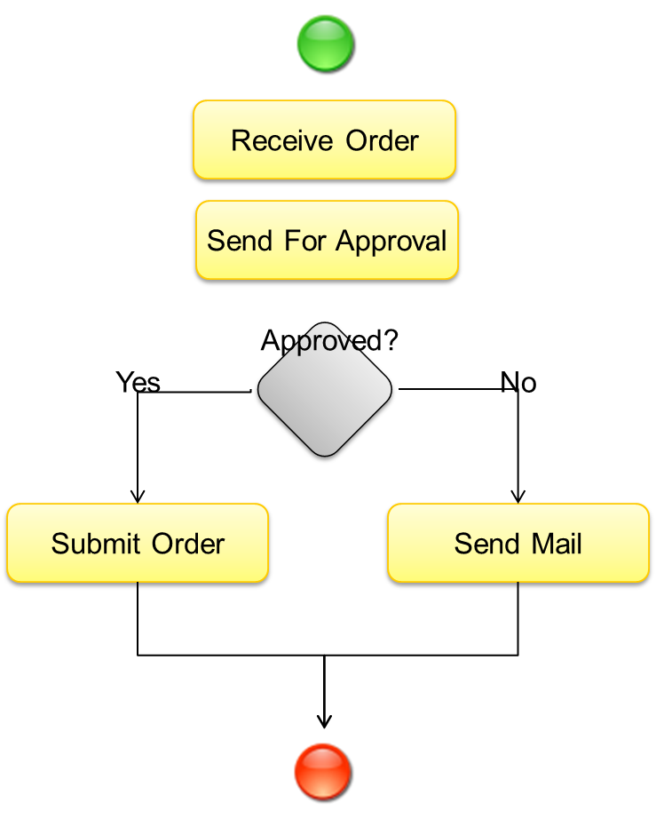
BizTalk Server Concepts
What is it called? | What is it?
Orchestrations | Model driven development and execution unit representing a process

Slide 50

BizTalk Architecture and Publish/Subscribe
Host
Host
Receive Port
Send Port
Receive Location
Adapter
Host
Adapter
Orchestration
Pipeline
Pipeline
Map
Map
Message Box
Messages
Subscriptions

Slide 51


Hands-On-Labs
Configure your first file integration with BizTalk Server
Working with the BizTalk Administration Console
Create a BizTalk Application
Create a Receive Port and Receive Location
Create a Send Port with filters
Send a file
Exercise 1

Slide 52
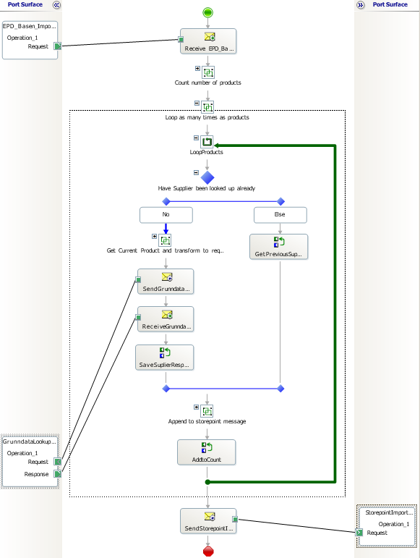

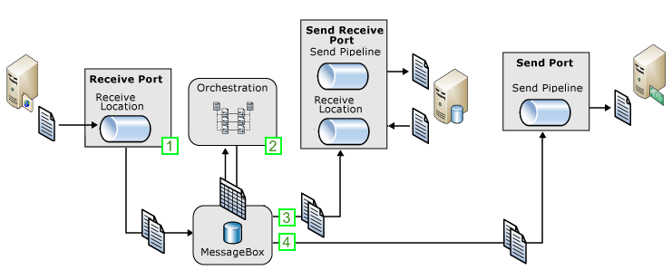
Typical Message flow scenario
Receive order, lookup data, send to subscriber
Receive message through a receive port.
An orchestration subscribes to the message to perform processing and enrichment.
As part of the processing messages are sent to a solicit-response send port (Web service) to lookup data
The message is enriched (mapped), to contain the sum of all parts.
When processing is completed the message is sent to the final recipient through a send port.

Slide 53
Lesson 2: BizTalk Server Development
Project Templates
Schemas and the Schema Editor
Transformations and the Mapper
Pipelines and the Pipeline Designer
Orchestrations and the Orchestration Designer

Slide 54
BizTalk Architecture
OTHER “STUFF”
Long running
Composite
Aggregate
Adapters
Transformations
Routing
Persistence
Hosting
Group
Host
Host instance

Slide 55
BizTalk Architecture
RFID
Rule Engine
Tracking
BAM
Trading Partners
EDI
Long running
Composite
Aggregate
Accelerators
Adapters
Transformations
Routing
Persistence
Hosting
Group
Host
Host instance

Slide 56
BizTalk Architecture
RFID
Rule Engine
Tracking
BAM
Trading Partners
EDI
Long running
Composite
Aggregate
Accelerators
Adapters
Transformations
Routing
Persistence
Hosting
Group
Host
Host instance

Slide 57
BizTalk Architecture
OTHER “STUFF”
PROCESS
MESSAGING
Hosting

Slide 58
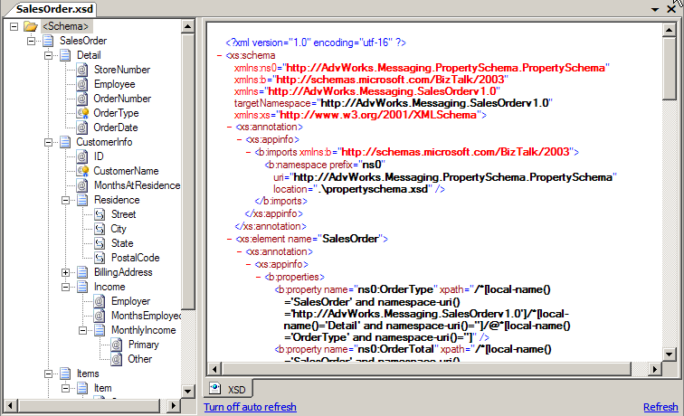
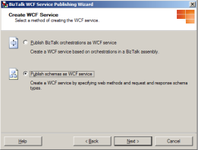
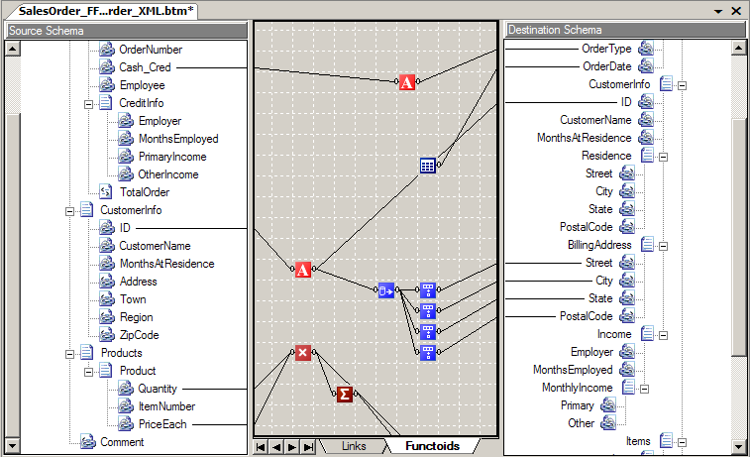


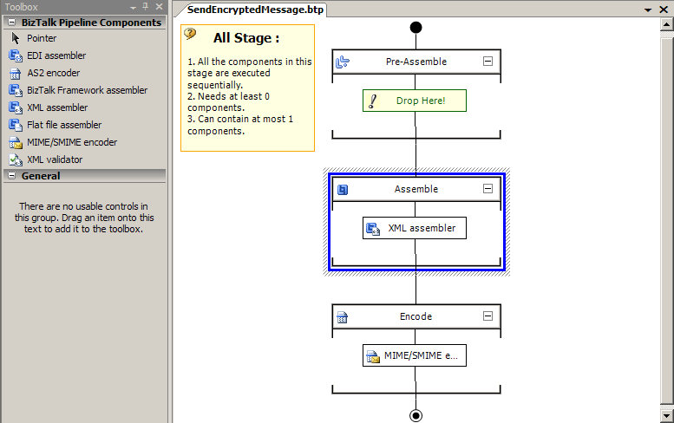
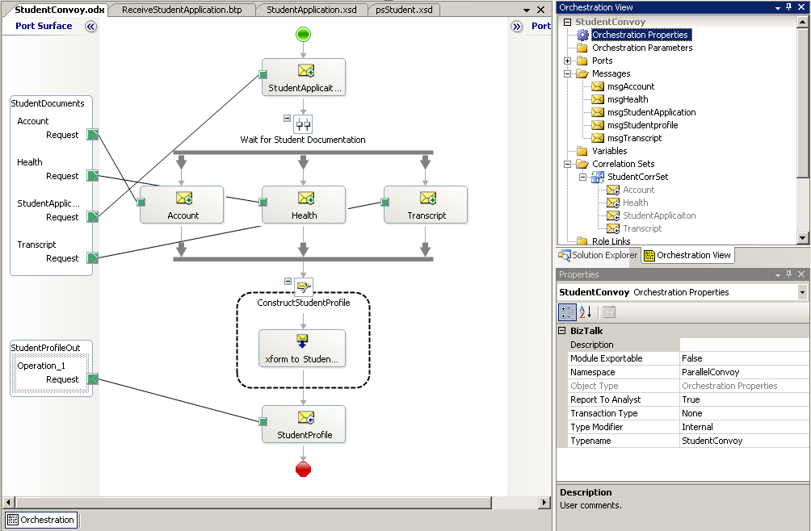
Tooling
Define Schemas
Rapid development
Transform Data
Wizards
BizTalk Mapper
BizTalk Editor
Design Business Processes
Process Messages
Orchestration Designer
Pipeline Designer
BizTalk Server 2006 – Visual Studio 2005
BizTalk Server 2009 – Visual Studio 2008
BizTalk Server 2010 – Visual Studio 2010
BizTalk Server 2013 – Visual Studio 2012

Slide 59
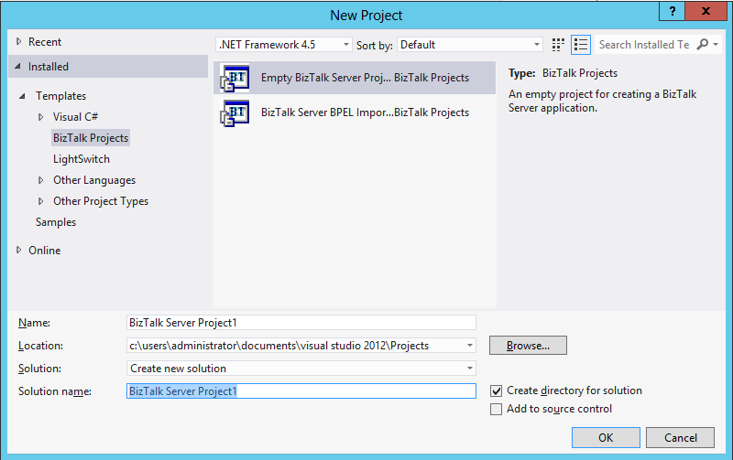

Project Templates
BT
BT
Empty BizTalk Server Project
BizTalk Server BPEL Import

Slide 60
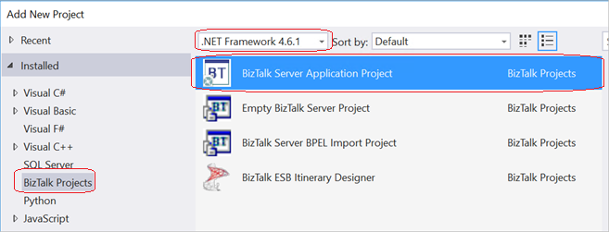
Feature Pack addition

Slide 61
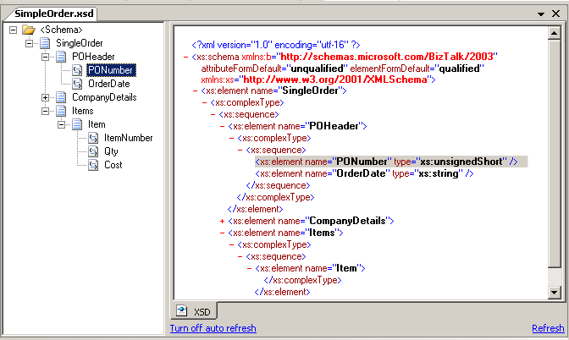
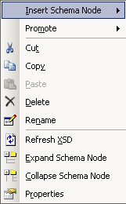
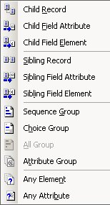
Schemas and the Schema Editor
Schemas represent the message data structure
Data is XML, delimited or positional
Editor options
Schema Tree View
XSD View

Slide 62
Maps and the Mapper
BizTalk maps are used for data transformation and translation
They are based on XSLT
Functoid
Source
Schema
Map Grid
Destination Schema

Slide 63


Pipelines…
Use pipelines to:
Normalize data from various formats to XML
Serialize data from XML to various formats
Assemble and disassemble messages
Decode and encode messages
Decrypt and encrypt messages
Assign and verify digital signatures
Pipeline Components

Slide 64
...and the Pipeline Designer
Stages
Toolbox
Designer Surface

Slide 65
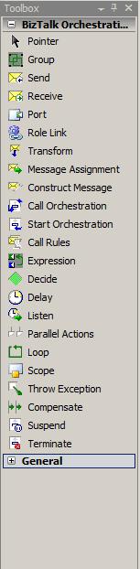
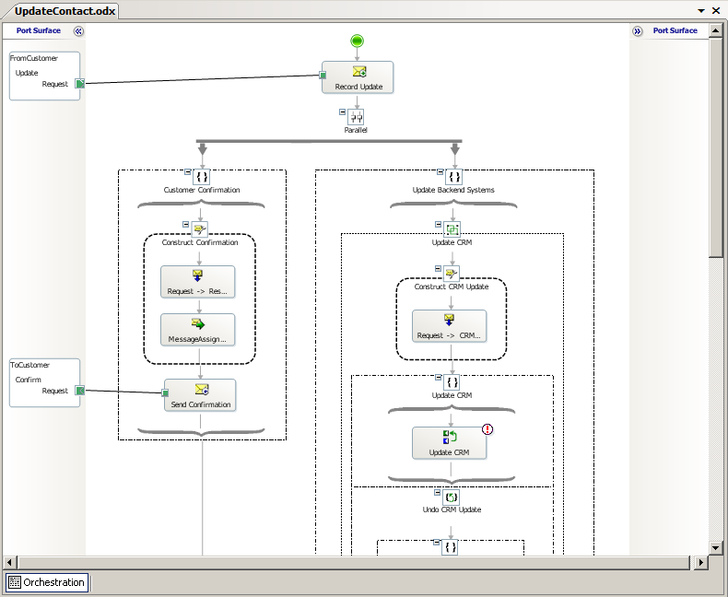
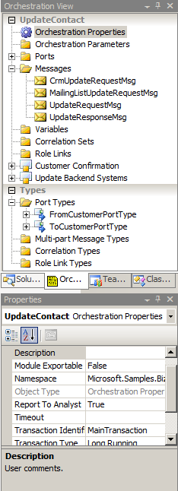
Orchestrations and the Orchestration Designer
Visual Designer
Pre-defined shapes
Drag-drop-configure
Not extensible, but the Expression shape allows you to do basically anything.
Design Surface
Orchestration view
Toolbox
Property Window
Port Surface

Slide 66
Demo
Creating a BizTalk project
Adding artifacts
Notes:
(Slide 36)
Open Visual Studio 2012
Create a new Empty BizTalk Server Project
Add a New Item – Schema – View the designer (very briefly)
Add a New Item – Map – View the mapper (very briefly)
Add a New Item Orchestration – View the designer (very briefly)

Slide 67
Hands-On-Labs
Building your first BizTalk Server solution
Create a BizTalk project in Visual Studio 2010
Create a schema
Create a map
Create an orchestration
Exercise 2-4

Slide 68
Lesson 3: BizTalk Server Administration
System requirements
BizTalk Server Administration Console
BizTalk run-time infrastructure

Slide 69
System requirements – BizTalk Server 2016
Minimum hardware requirements
Minimum software requirements
1 GHz or higher for single processors
32-bit
2 GB of RAM
10 GB of available hard disk space
Windows Server 2016
Windows 8.1
SQL Server 2014 SP1 Std
.NET 4.6
Recommended hardware
Recommended software
1 Quad/Hexa/Octo core processor
64-bit
8 GB or more of RAM
45+15 GB or more available hard disk space
Windows Server 2016
Windows 10
SQL Server 2016 Ent

Slide 70
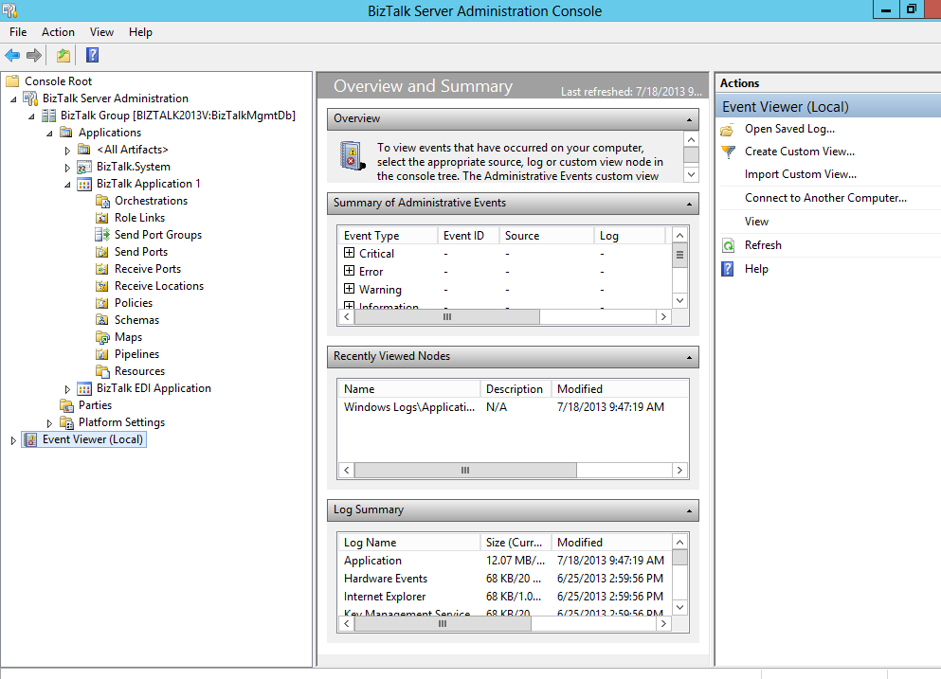
Administration Console
Configuration and Management
Applications
Ports, Adapters, Pipelines
Orchestrations
Start, Stop
Import, Export
Troubleshoot
MMC Console

Slide 71
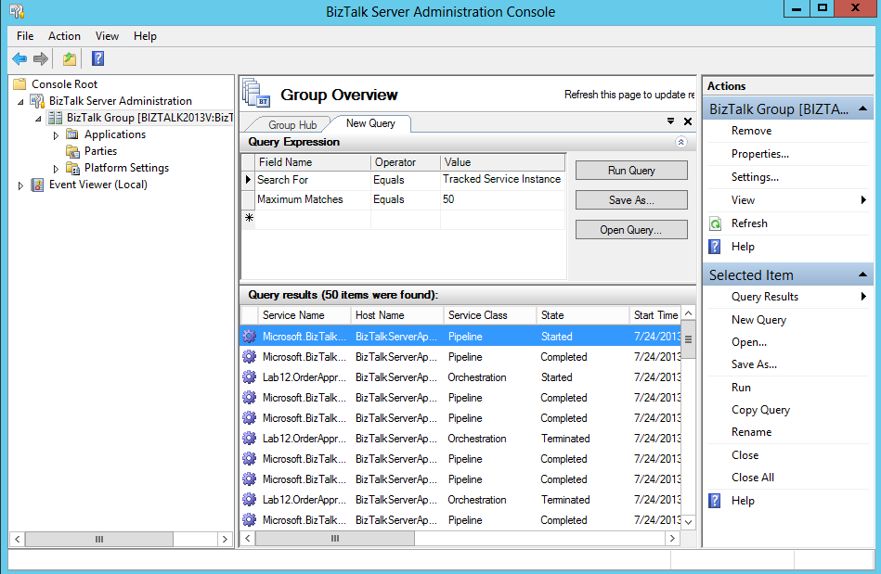
Viewing Tracking Information
Health And Activity Tracking

Slide 72
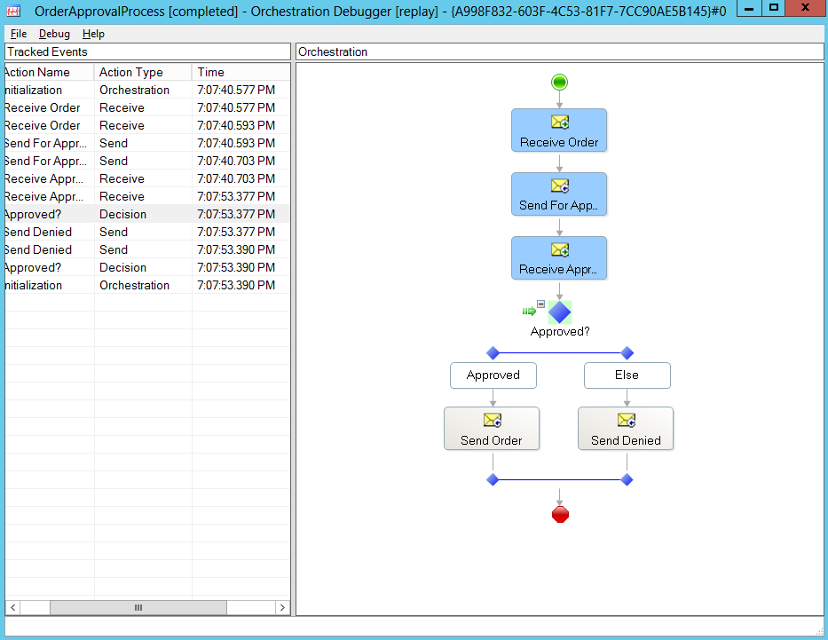
HAT - Orchestration Debugger
Debugging
Monitor orchestration instances and messages
Set breakpoints
Suspend, terminate, or resume processes
View variables and data
Orchestration Debugger

Slide 73
Summary
Microsoft BizTalk Server is used to simplify and automate the exchange of information between publishers and subscribers, to orchestrate business processes and to supply insight into processes.
It builds on a very solid infrastructure.
And has a wide range of tools to support administration and development tasks.

Slide 74
Q & A
Introduction to BizTalk Server 2016

Slide 75
Hands-On-Labs
Deploying and running your solution
Deploy a BizTalk solution and configure it
Create ports to receive and send messages
Test the integration
Exercise 5-6

Slide 76

Quiz
What are some of the scenarios where Microsoft BizTalk Server can be used?
What are some of the tools utilities used within BizTalk Server development and administration?
What would be the appropriate version for a single box production machine?
What is the function of a port?

